Slide 1

Coca-Cola’s Marketing

Slide 2
How does Coca-Cola market their product?

Slide 3
Segmentation and Targeting
Geographic
200 countries
Psychographic
Social class – working class
Demographic
Mainly 10-35 for the regular product
People with specific diet concerns
User status and benefits sought
Behavioral
Notes:
Targeting: Coca-cola has positioned itself as a refreshing drink, to be shared with loved ones. It does this by adapting their market strategy to the specific audiences they cater for. Such as geographic regions and countries. A great example of this would be coca cola flyers. They differ from country to country. The people used in the advertisements look different based on the region. This is known as market segmentation. It's the process of dividing large markets of consumers into subgroups based on shared characteristics. They use different segmentation tactics. We’ll explore the main four; geographic, demographics, psychographic and behavioural.
Geographic:
- 200 countries (presence in 200) and caters accordingly to each country.
- season/climates: In Christmas the way their products are marketed is vastly different from the way it's done in the summer.
During the summer the emphasis focuses on the refreshing aspect of it while during the Christmas season, the emphasis is placed on it being a drink that brings people together.
Demographics:
- Age 10-35.
- They have events for that as well eg: Coca-cola concert on the beach in Bulgaria. Coca-cola shows in east Africa for musicians.
- Older, middle-aged, diabetic, or health-conscious consumers: - They have diet options such as zero coke, and diet coke.
- Race: According to the race/region they use different people in their advertisement.
Their target audience is the user between the ages of 10 to 35. With other secondary products for older customers, diabetics as well diet-conscious consumers. They target their main consumers by creating events, shows and concerts specifically targeting the first demographic. And rely on celebrity endorsement for secondary demographics. They use celebrities like Kate Moss and other famous supermodels to promote these products.
Psychographic:
- Social class and lifestyle: The have different sizes to cater to people that are conscious about their spending.
- Lifestyle: Their advertisement make it seem like it's a drink to be shared with family and friends.
Their target audience is working-class everyday consumers. The drink is affordable enough for most consumers and does not seem too exclusive based on price.
Behavioural:
Benefit sought, for celebrity endorsement.
For their diet alternatives the celebrity endorsement imply that drinking their cola alternatives can give you access to the same benefits that these celebrities have. Whether that be a slimmer-looking figure amongst many other things.

Slide 4
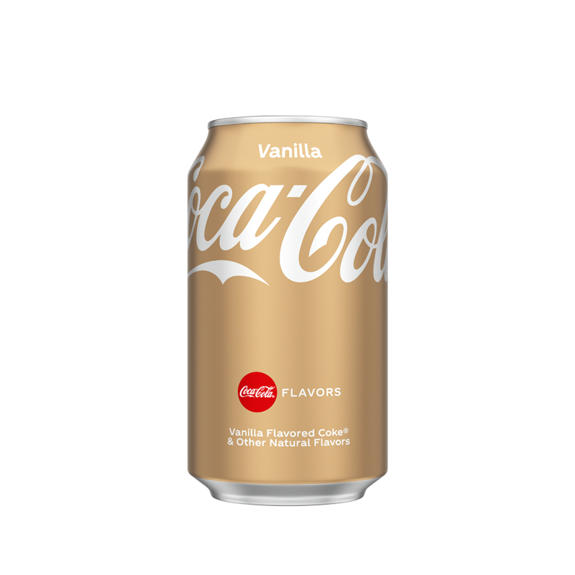
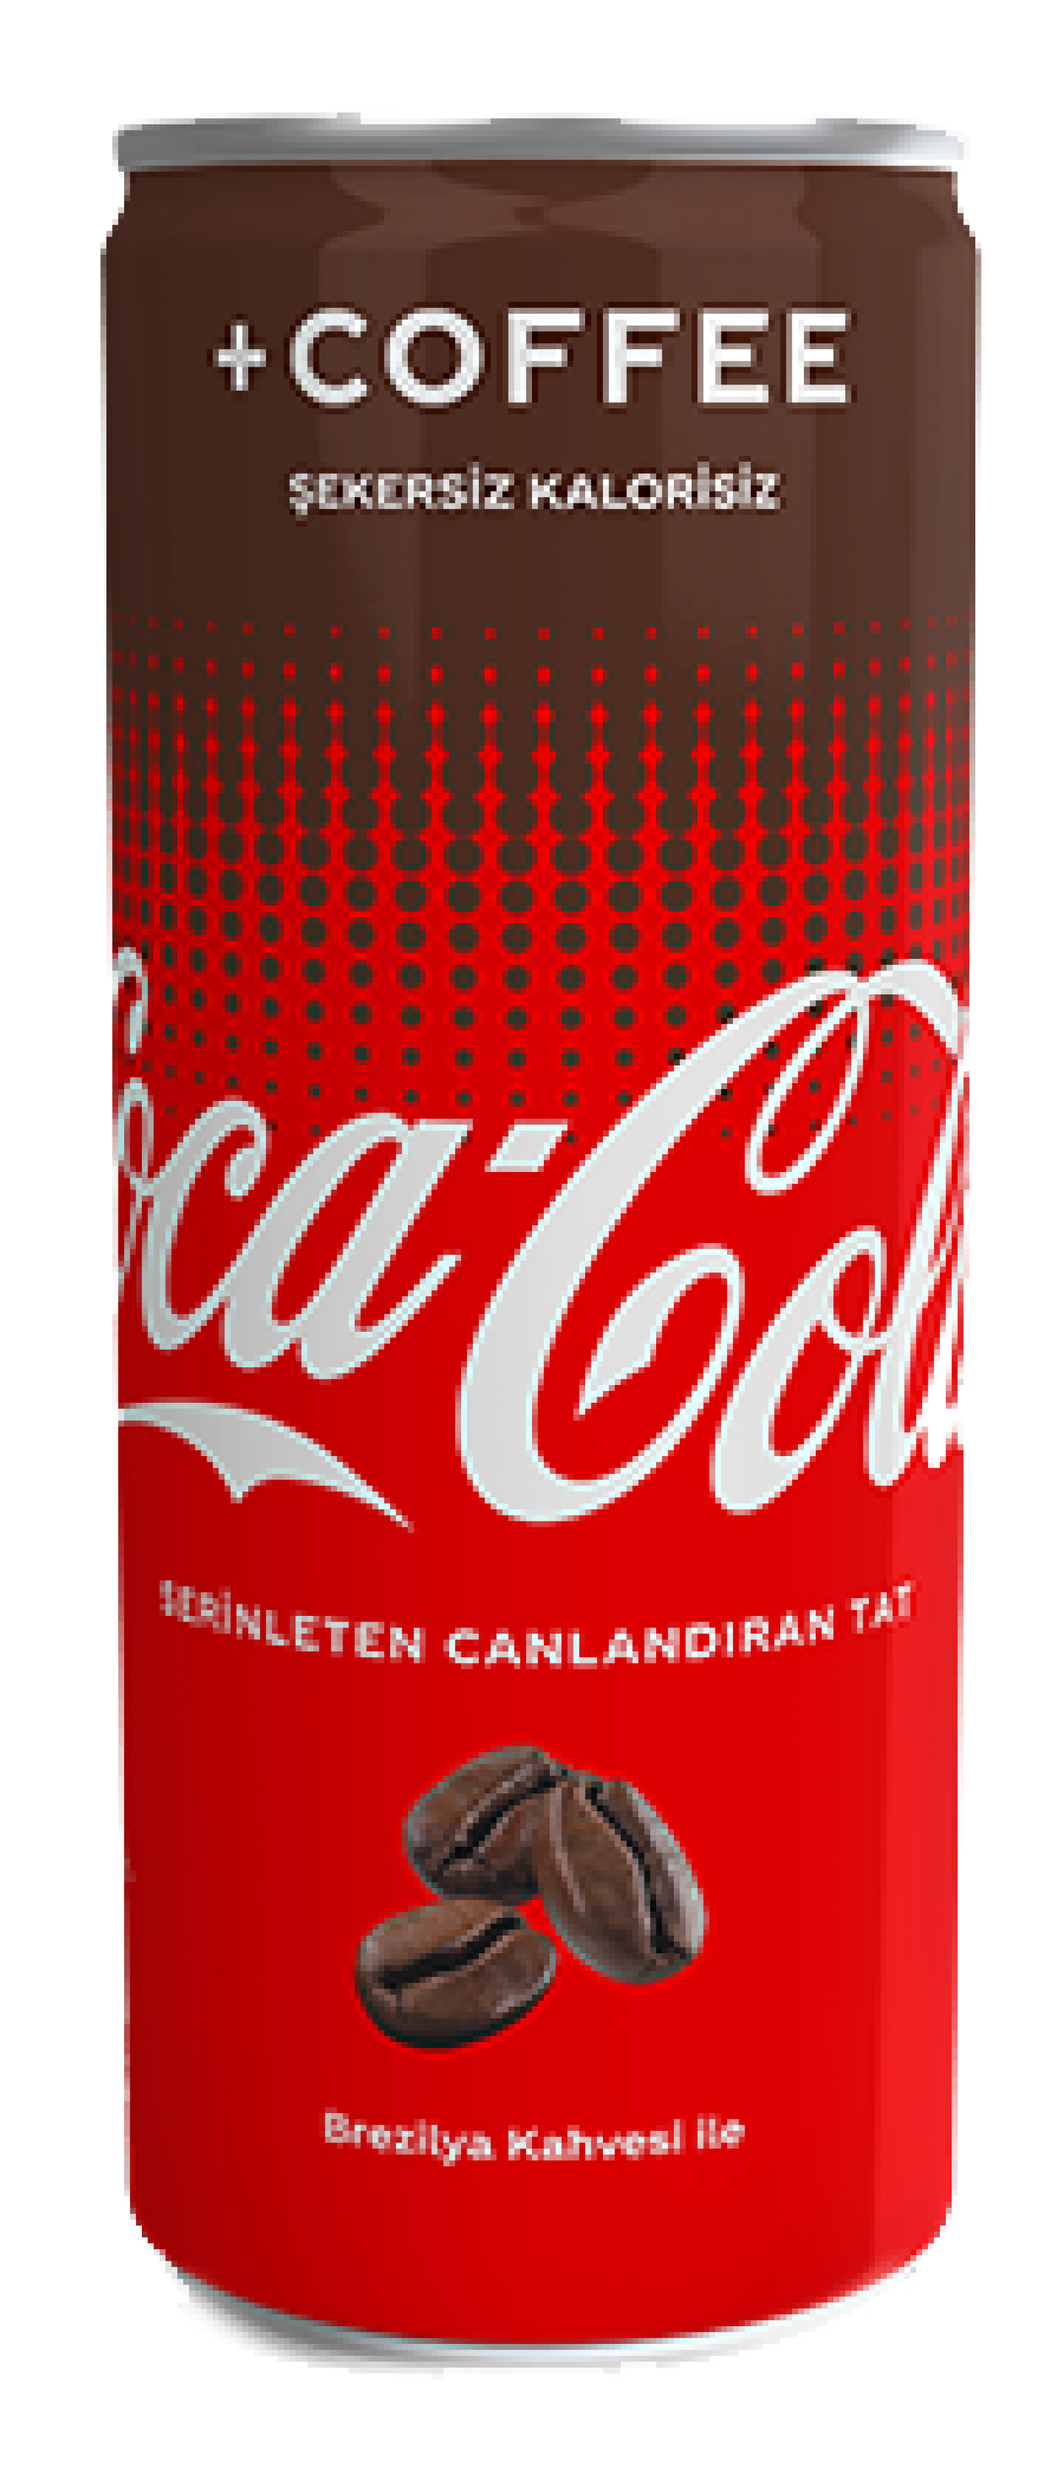
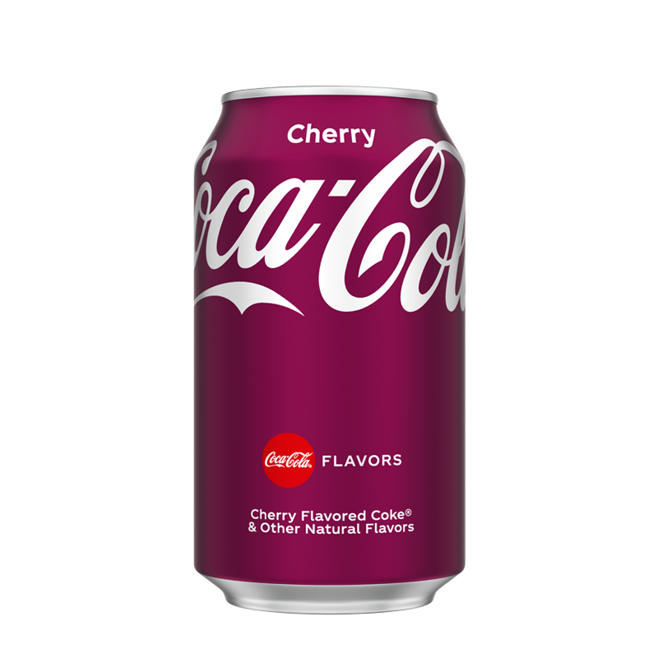

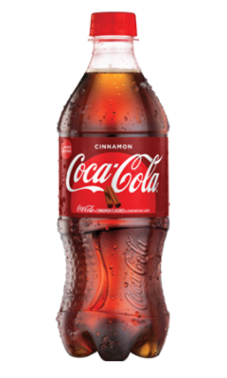

Slide 5
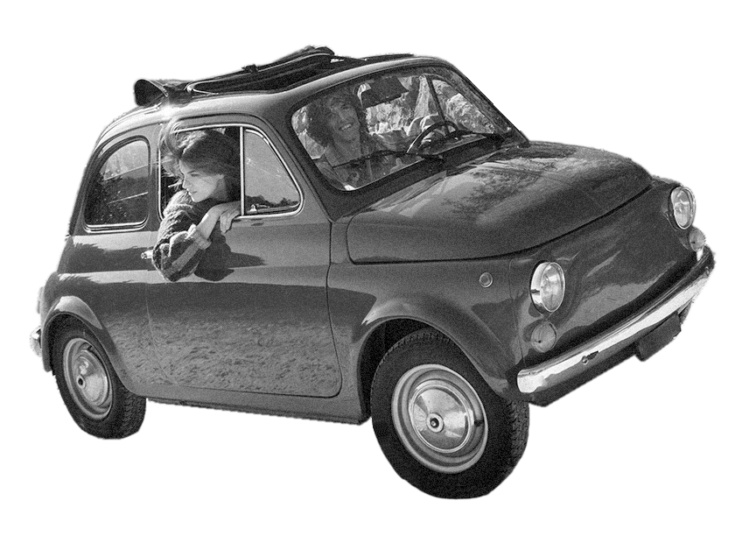
Thank you for your attention!
Any questions?

